Slide 1


The Monte Carlo method
The Monte Carlo method is a statistical technique used to find an approximate solution through sampling.
For instance, the Monte Carlo method approximates the expectation of a random variable by sampling, and when the sample size is greater, the approximation will be be better
Let's suppose we have a random variable X and say we need to compute the expected value of X; that is E(X), then we can compute it by taking the sum of the values of X multiplied by their respective probabilities as follows:
Using Monte Carlo Method, We can estimate the expected value of X by just sampling the values of X for some N times and compute the average value of X as the expected value of X as follows,

Slide 2
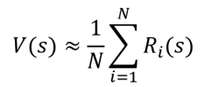






Monte Carlo Prediction
In the prediction task, we will be given a policy and we predict the value function or Q function using the given policy to evaluate it. .
The Monte Carlo method is a model-free method, meaning that it doesn't require the model dynamics to compute the value function.
In order to approximate the value of the state using the Monte Carlo method, we sample episodes (trajectories) following the given policy for some N times and then we compute the value of the state as the average return of a state across the sampled episodes, and it can be expressed as:
we can understand that the value of a state s can be approximated by computing the average return of the state s across some N episodes. Our approximation will be be
Consider three trajectories(Episodes) of grid world environment and their return as as follows,

Slide 3


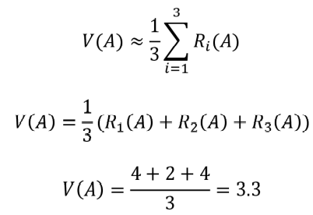
Monte Carlo method, the value of a state can be approximated by computing the average return of the state across some N episodes (trajectories):
We need to compute the value of state A, so we can compute it by just taking the average return of the state A across the N episodes as
We generated three episodes, thus:
Similarly, we can compute the value of all other states by just taking the average return of the state across the three episodes. For easier understanding, in the preceding example, we only generated three episodes.
In order to find find a better and more accurate estimate of the value of the state, we should generate more episodes and compute the average return of the state as the value of the state.

Slide 4
First Visit Monte Carlo Prediction
We know that in each episode a state can be visited multiple times. In the first-visit Monte Carlo method, if the same state is visited again in the same episode, we don't compute the return for that state again.
For example, consider a case where an agent is playing snakes and ladders. If the agent lands on a snake, then there is a good chance that the agent will return to a state that it had visited earlier. So, when the agent revisits the same state, we don't compute the return for that state for the second time.
Every Visit Monte Carlo Prediction
Every-visit Monte Carlo is just the opposite of first-visit Monte Carlo. Here, we compute the return every time a state is visited in the episode.
Only difference between the first-visit MC and every-visit MC methods is that in the first-visit MC method, we compute the return for a state only for its first time of occurrence in the episode but in the every-visit MC method, the return of the state is computed every time the state is visited in an episode.
We can choose between first-visit MC and every-visit MC based on the problem that we are trying to solve

Slide 5


Monte Carlo Control
In the control task, our goal is to find the optimal policy. Unlike the prediction task, here, we will not be given any policy as an input. So, we will begin by initializing a random policy, and then we try to find the optimal policy iteratively.
Policy can be extracted from the Q function. That is, if we have a Q function, then we can extract policy by selecting an action in each state that has the maximum Q value as the following shows:
We can perform the same MC Prediction step here to compute the Q function. But in the control method, we are not given any policy as input.
So, we will initialize a random policy, and then we compute the Q function using the random policy. That is, just like we learned in the prediction method, we generate several episodes using our random policy. Then we compute the Q function (Q value) as the average return of a state-action pair across several episodes.

Slide 6
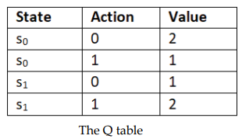

Let's suppose after computing the Q function as the average return of the state-action pair, Q function looks like,
From the preceding Q function, we can extract a new policy by selecting an action in each state that has the maximum Q value.Thus, our new policy selects action 0 in state s0 and action 1 in state s1 as it has the maximum Q value.
Now that we have extracted a new policy from the Q function, we can use this new policy to generate episodes in the next iteration and compute the new Q function. Then, from this new Q function, we extract a new policy. We repeat these steps iteratively until we find the optimal policy
Note that here, we select the policy in a greedy manner meaning that we are selecting policy by just taking the maximum Q value, and so we can call our policy a greedy policy.

Slide 7
We can classify the control methods into two types: On-policy control , Off-policy control
On-policy control: In the on-policy control method, the agent behaves using one policy and also tries to improve the same policy. That is, in the on-policy method, we generate episodes using one policy and also improve the same policy iteratively to find the optimal policy.
Off-policy control: In the off-policy control method, the agent behaves using one policy b and tries to improve a different policy . That is, in the off-policy method, we generate episodes using one policy and we try to improve the different policy iteratively to find the optimal policy.
On-policy Monte Carlo control
There are two types of on-policy Monte Carlo control methods:
Monte Carlo exploring starts
Monte Carlo with the epsilon-greedy policy
In the MC exploring starts method, we set all state-action pairs to a non-zero probability for being the initial state-action pair. So before generating an episode, first, we choose the initial state-action pair randomly and then we generate the episode starting from this initial state-action pair following the policy .
One of the major drawbacks of the exploring starts method is that it is not applicable to every environment. That is, we can't just randomly choose any state-action pair as an initial state-action pair because in some environments there can be only one state-action pair that can act as an initial state-action pair. So we can't randomly select the state-action pair as the initial state-action pair.

Slide 8
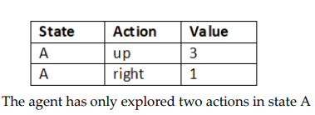
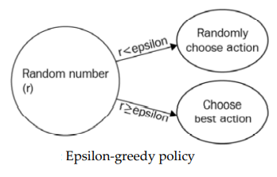
Monte Carlo with the epsilon-greedy policy
A greedy policy is one that selects the best action available at the moment. For instance, let's say we are in some state A and we have four possible actions in the state. Let the actions be up, down, left, and right. But let's suppose our agent has explored only two actions, up and right, in the state A; the Q value of actions up and right in the state A.
As the action up has the maximum Q value. So our greedy policy selects the action up in state A.
Now the question is whether the agent should explore all the other actions in the state and select the best action as the one that has the maximum Q value or exploit the best action out of already explored actions. This is called an exploration-exploitation dilemma.
To avoid this dilemma, we introduce a new policy called the epsilon greedy policy. Here, all actions are tried with a non-zero probability (epsilon). With a probability epsilon, we explore different actions randomly and with a probability 1-epsilon, we choose an action that has the maximum Q value. That is, with a probability epsilon, we select a random action (exploration) and with a probability 1- epsilon we select the best action (exploitation).

